Slide 1
Assessing Greenspace in Leeds
By (names removed for anonymity)

Slide 2
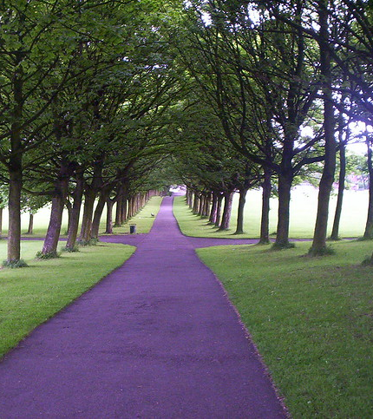
Background: Greenspace in Leeds
Leeds has approximately 4000 hectares of council-managed public greenspace
Women, older people and those with health conditions are significantly underrepresented in greenspaces (Ward et al., 2023)
Participants of Ward et al.’s (2023) study showed the need for physical improvements to greenspace quality within Leeds, as well as easier access and transport
Greenspace within cities is typically not equitably distributed and is challenging to measure (Wolch et al., 2014)
Image source: Hyde Park, Leeds - A photo on Flickriver. (no date). Flickriver. [Online]. [Accessed 11 February 2025]. Available from: https://www.flickriver.com/photos/76879798@N00/140559923/

Slide 3
Nature Connection Health Benefits
Physical
Mental
Enhanced immune function
Reduced allergies
Improved respiratory health
Encourages physical activity
Reduced post-operation recovery times
Lower use of pain medication
Mitigation of environmental stressors
Improved psychological well being
Improved mood
Increased restorative effects
Reduced anxiety, fatigue; enhanced cognitive function
All the above improve help to increase physical symptoms
(Aerts et al., 2018; Totaforti, 2018; Fields in Trust; Houlden, Jani, and Hong, 2021; Marselle et al., 2021; Nguyen et al., 2021)
Notes:
Green spaces in the UK are estimated to save the NHS between £100 million and £111 million per year.

Slide 4
Importance of Biodiversity
Greenspaces with higher biodiversity shown to be related to better well-being compared to greenspaces low in biodiversity (Marselle et al., 2018; Houlden et al., 2021)
Species richness – the number of different species present
Aerts et al. (2018) found 24 significantly positive associations between biodiversity indicators and human health.
Species abundance – the number of individual organisms in a taxonomic group present
Cox et al. (2017) found higher bird abundances were associated with less depression, anxiety and stress in England.
Marselle et al. (2016) found that abundance of street trees, significantly reduced the risk of antidepressant prescriptions for individuals with low socio-economic status in the city of Leipzig.
Managed areas
Hussain et al. (2018) found managed meadows, with higher species richness and abundance, had more positive human health associations than the abandoned meadows.
Notes:
Aerts, R., Honnay, O. and Van Nieuwenhuyse, A., 2018. Biodiversity and human health: mechanisms and evidence of the positive health effects of diversity in nature and green spaces. British medical bulletin, 127(1), pp.5-22.
Cox, D.T., Shanahan, D.F., Hudson, H.L., Fuller, R.A., Anderson, K., Hancock, S. and Gaston, K.J., 2017. Doses of nearby nature simultaneously associated with multiple health benefits. International journal of environmental research and public health, 14(2), p.172.
Marselle, M.R., Irvine, K.N., Lorenzo-Arribas, A. and Warber, S.L., 2016. Does perceived restorativeness mediate the effects of perceived biodiversity and perceived naturalness on emotional well-being following group walks in nature?. Journal of Environmental Psychology, 46, pp.217-232.

Slide 5
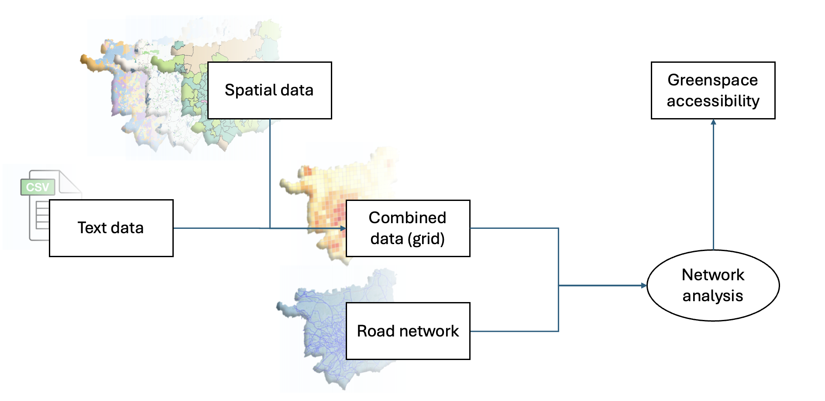
Overall Objective (Methods + Approach)
Evaluate the accessibility of green spaces within MSOA areas and their impact on different population groups to optimize urban green space planning and accessibility analysis.
Approach:
Green Space Distribution Analysis
- Identify public/designated green spaces within MSOA areas
15-Minute Accessibility Analysis
- Calculate the reachable green space areas within a 15-minute travel time using network analysis and evaluate accessibility disparities
Population Composition Analysis
- Assess the demographic composition of the population in MSOA areas and analyze green space demand among different classifications
Notes:
Examined location and proportions of public/designated green spaces per MSOA
Created 15-minute walking buffers around designated green spaces

Slide 6
Data Description
Name | Description | Data Type | Source (URL)
Definitive Paths in Leeds | Leeds City Council Area public rights of way | Shapefile | https://www.data.gov.uk/dataset/f3233ce2-1fe6-4b86-88f4-40b31710a874/leeds-public-rights-of-way
Collated Designated Areas Boundaries | Four datasets collated showing boundaries for the legally designated areas for conservation in Leeds (Ancient Woodland, LNR, SPA and SSSI) | Shapefile | https://naturalengland-defra.opendata.arcgis.com/search
OS Greenspace Boundaries | Dataset showing the boundaries of greenspaces in Leeds including playing fields, sports’ facilities, play areas and allotments. | Shapefile | https://osdatahub.os.uk/downloads/open/OpenGreenspace
UK Output Area Classification (OAC) | Dataset showing a hierarchical geodemographic classification which identifies neighborhoods in England | Shapefile | https://data.cdrc.ac.uk/dataset/uk-output-area-classification-uk-oac
Leeds MSOA Boundaries | Middle Layer Super Output Areas (MSOA) within Leeds | Shapefile | https://observatory.leeds.gov.uk/guidance/
Notes:
Collated Designated Areas Sources:
Ancient Woodland - https://naturalengland-defra.opendata.arcgis.com/datasets/a14064ca50e242c4a92d020764a6d9df_0/explore?location=52.793984%2C-2.004678%2C6.71
LNR - https://naturalengland-defra.opendata.arcgis.com/datasets/b1d690ac6dd54c15bdd2d341b686ecd7_0/explore?location=53.706152%2C-1.692937%2C8.75
SPA - https://naturalengland-defra.opendata.arcgis.com/datasets/e6ee43be14554663b0a80bb42aa4e671_0/explore?location=52.691841%2C-2.229306%2C6.68
SSSI - https://naturalengland-defra.opendata.arcgis.com/datasets/f10cbb4425154bfda349ccf493487a80_0/explore?location=53.695421%2C-1.323068%2C9.84

Slide 7
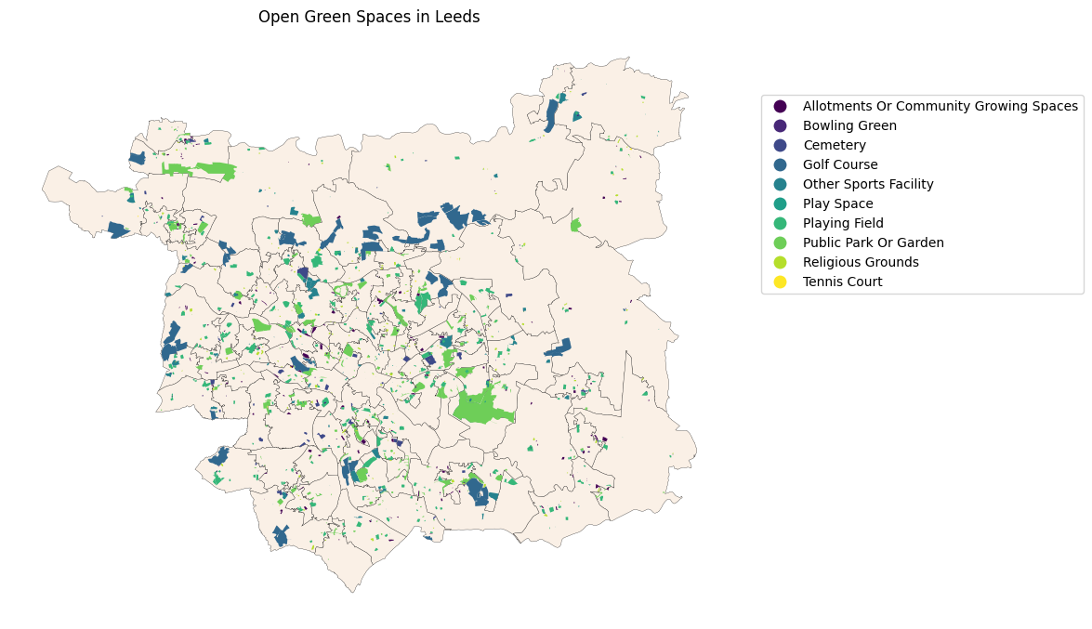
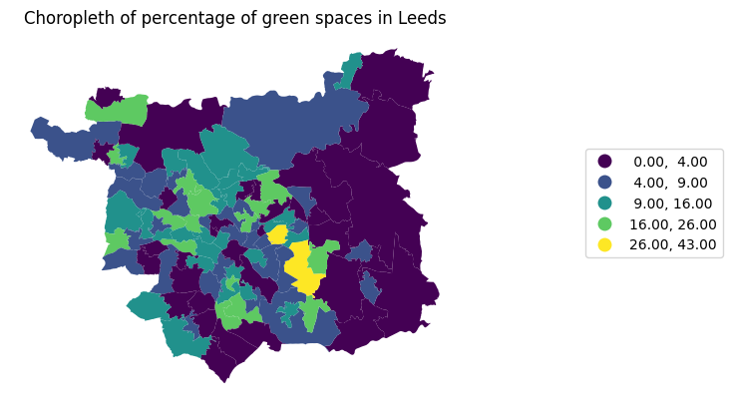
Visualisations
Distribution and Types of Greenspace
Proportion of Greenspace per MSOA

Slide 8
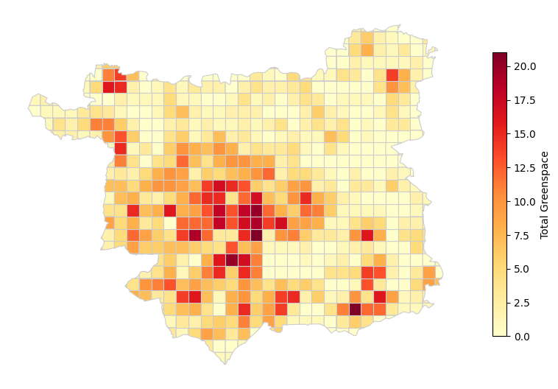
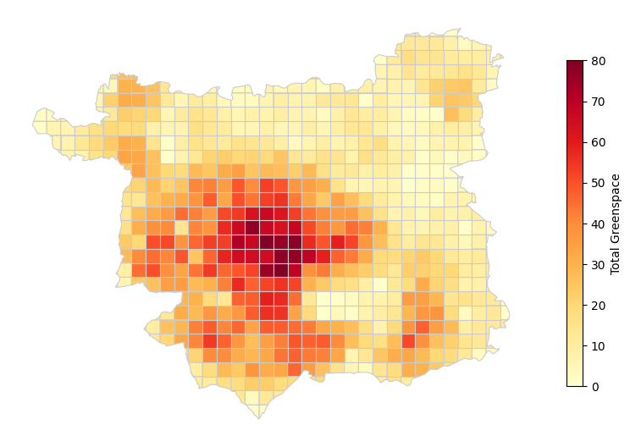
15-minute Greenspace Accessibility
Walking
Cycling
Notes:
Walking – lack in city centre
Both – lack in north and east

Slide 9
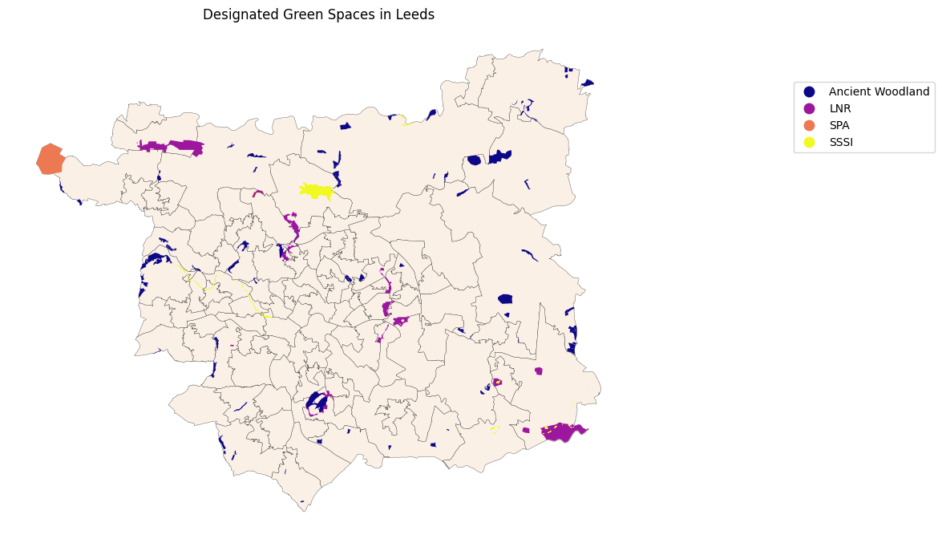
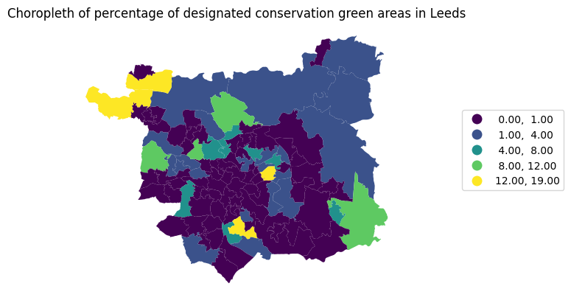
Distribution and Types of Designated Sites
Proportion of Designated Sites per MSOA
Notes:
Ancient Woodlands
AONB – Areas of outstanding beauty
LNR – Local nature reserves
RAMSAR - Wetlands of international importance
SAC – Special areas of conservation
SPA – Special protected areas
SSSI – Special sites of scientific interest

Slide 10
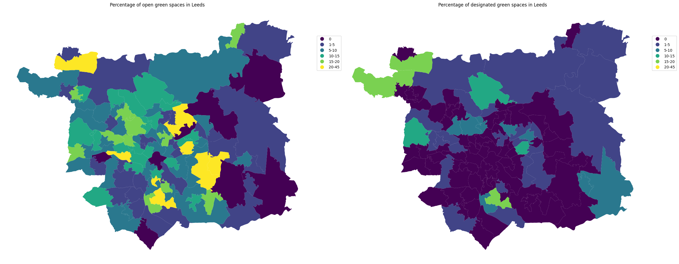
Proportion of Greenspace per MSOA
Proportion of Designated Sites per MSOA

Slide 11
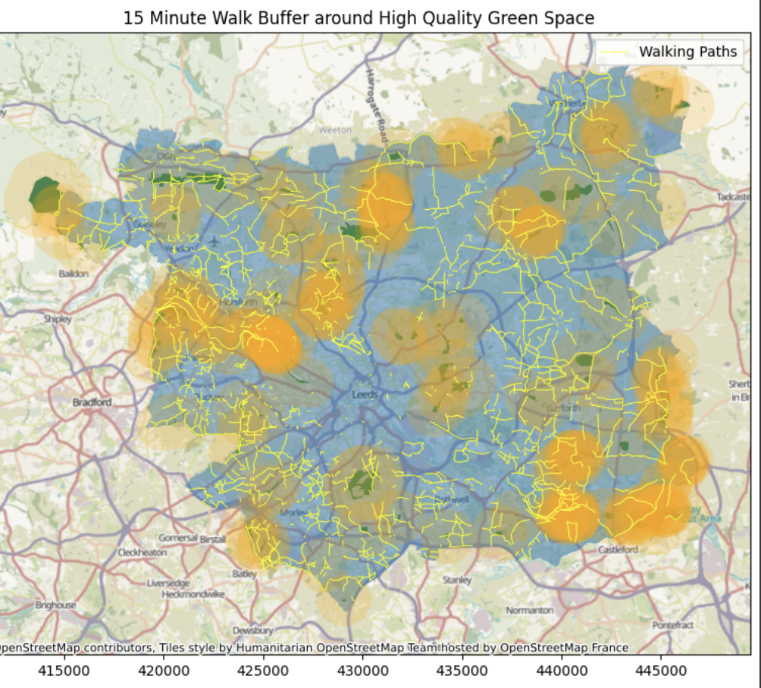
There is a lack of high-quality green space (designated spaces) within a 15-minute walk from the city centre
Some isolated areas have no access to high quality green space

Slide 12
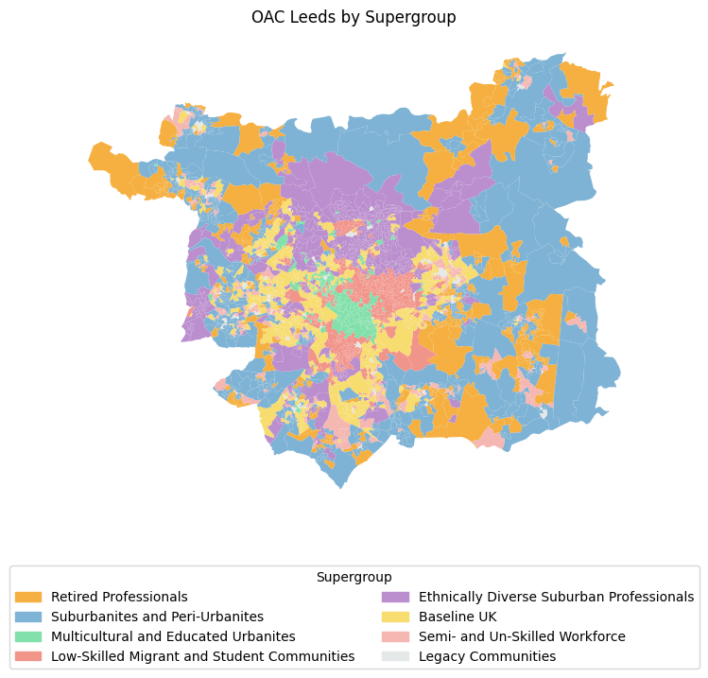
Output Area Classification in Leeds
Population Group | Description
Retired Professionals | Retired, Professional, Affluent
Suburbanites and Peri-Urbanites | Suburban, Stable, Commuter
Multicultural and Educated Urbanites | Diverse, Educated, Urban
Low-Skilled Migrant and student Communities | Migrant, Low-skilled, Student
Ethnically Diverse Suburban Professionals | Diverse, Professional, Suburban
Baseline UK | Typical, Middle-class
Semi- and Un-Skilled Workforce | Manual, Low-income, Labor
Legacy Communities | Traditional, Established, Historic
Notes:
Retired Professionals:
Retired, highly educated professionals with stable income and high quality of life demands.
Suburbanites and Peri-Urbanites:
Residents in suburban/peri-urban areas who value larger living spaces and a good environment.
Multicultural and Educated Urbanites:
Diverse, well-educated urban dwellers with strong cultural awareness and higher consumption power.
Low-Skilled Migrant and Student Communities:
Low-skilled migrants and students with limited income and a high need for basic public services.
Ethnically Diverse Suburban Professionals:
High-income suburban professionals from diverse ethnic backgrounds with unique cultural needs.
Baseline UK:
Typical middle-class UK families representing standard living conditions and balanced public service needs.
Semi- and Un-Skilled Workforce:
Workers with lower skills and income facing high physical demands and limited resource access.
Legacy Communities:
Long-established communities with deep cultural roots but potentially outdated infrastructure.

Slide 13
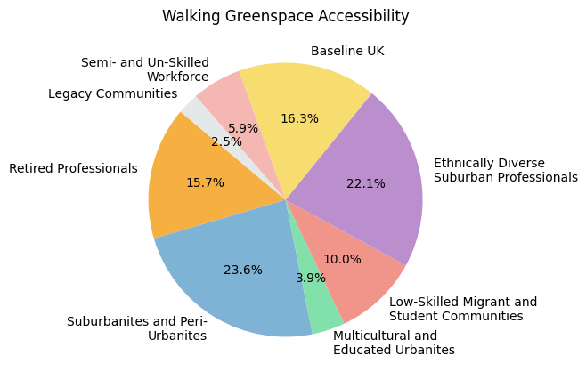
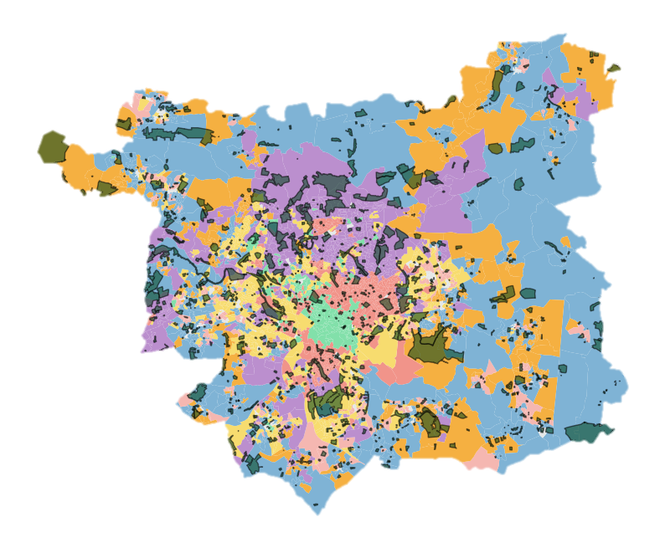
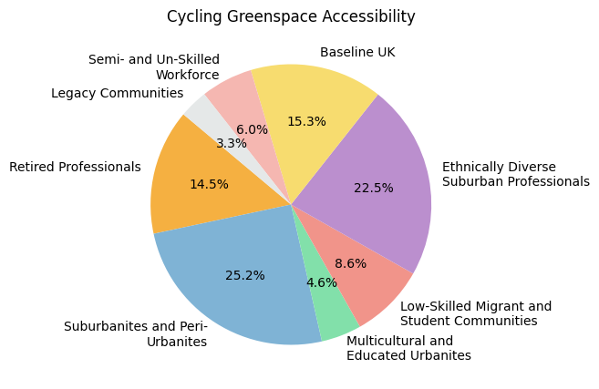
15-minute Greenspace Accessibility by OAC group
Greenspace

Slide 14
Solutions (and financial considerations)
Solutions
Manage existing public greenspaces to increase biodiversity e.g. no mow areas, diversity of species planted, species specific nest boxes, artificial habitats (insect hotels), designated dead wood areas
Engage local communities and volunteer groups (such as Friends of and In Bloom) to manage greenspaces for biodiversity
‘Just Green Enough’ strategy (Curran and Hamilton, 2012) to promote small scale green interventions, like pocket parks
Financial Considerations
Volunteer schemes
Community workshops – building nest boxes (tools, materials, employee fee) – charge entrance fees
Education schemes
Budget in place for tree planting in Leeds
Grants for creating more green spaces
Some examples include … Community Green Spaces Fund, Parks for People, etc.

Slide 15
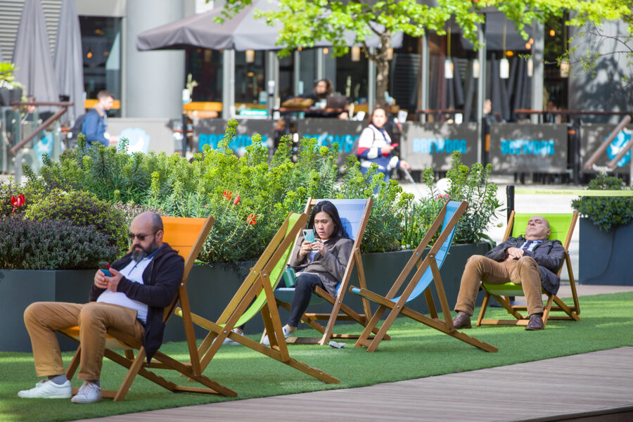
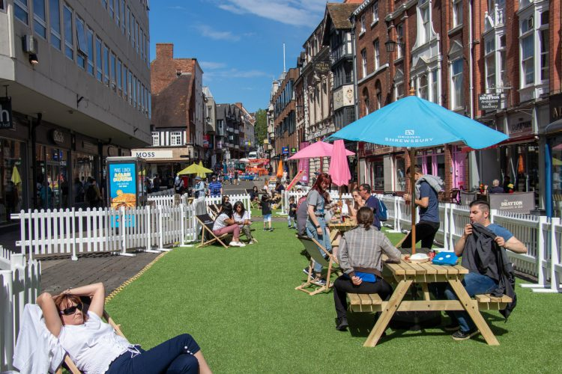
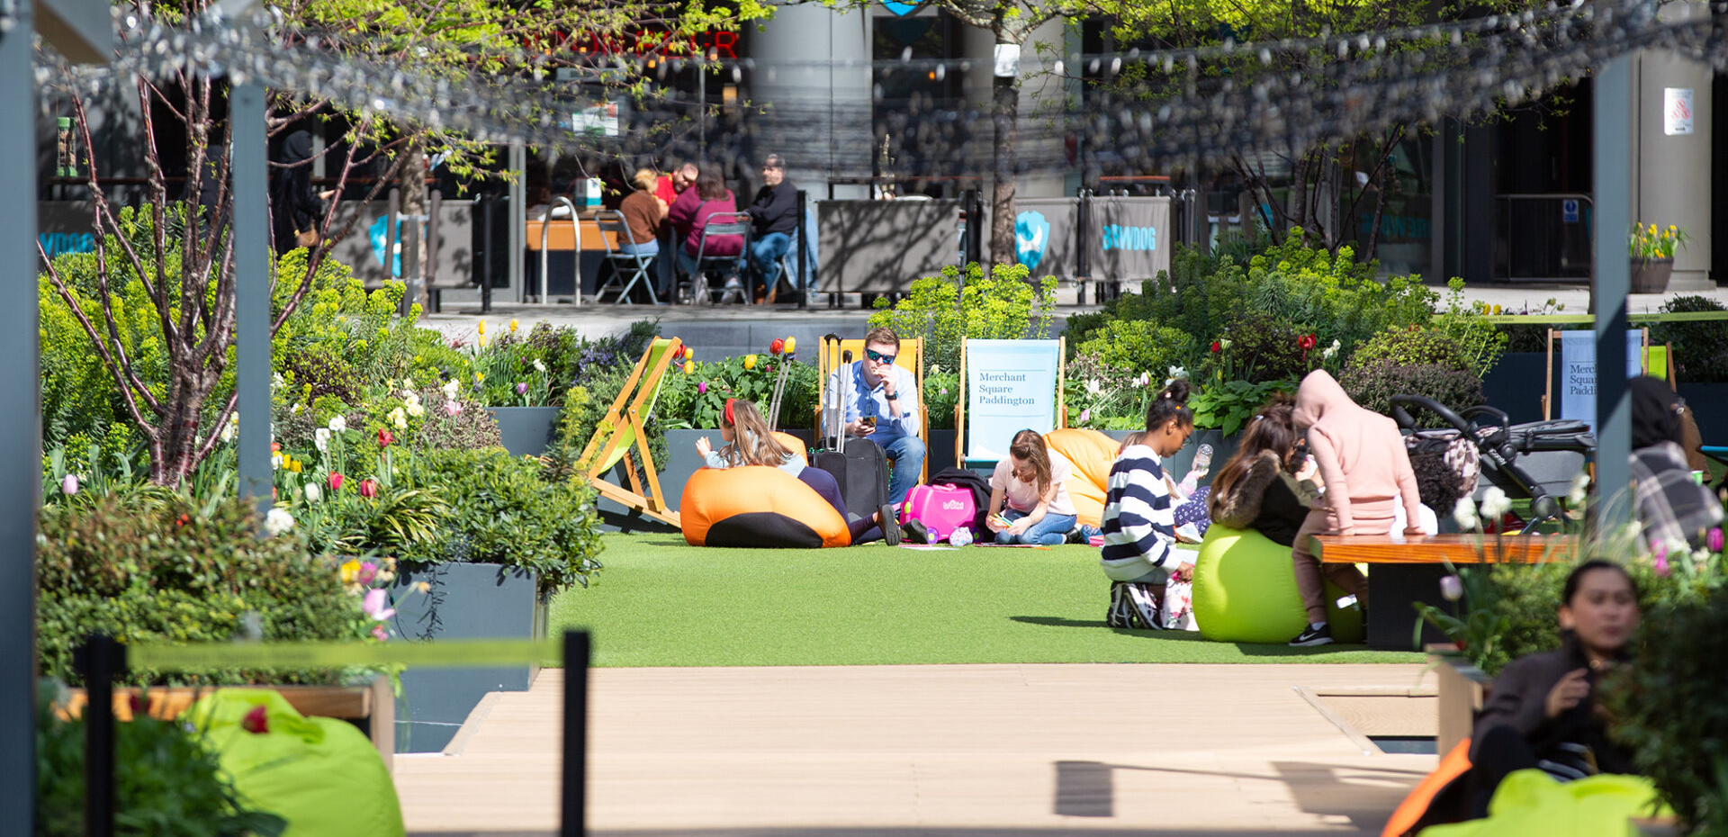
Solutions: Pocket Park
SPACE
ENVIRONMENT
SOCIETY
WELL DESIGNED POCKET PARK
Pocket parks are usually found in built-up urban spaces to address the need for public activity spaces in high-density urban areas
Transforms any unused, derelict space it is set-up in
Brings local community together
Site Selection
Near the city center
Size
Park size should be 300 to 600 m2 range in case of a park created by local community.
Park should serve a resident population of approximately 500-1000-person max
MITIGATING UHI IMPACTS
PROMOTING QUALITY OF LIFE
Emotional wellbeing
Interpersonal relations
Material wellbeing
Physical wellbeing
Self-determination
Saved:
around £50,000 per year per park
Funding: Government grants of £20,000-£40,000 per park
Outcome:
40% increase in green coverage, 60% increase in resident usage
(Sinou, 2013; Blake, 2014; Abd El Aziz, 2017)
(Turcu, 2024)

Slide 16
Limitations
Higher quality walkway data
Focus on lower-level output areas, MSOAs are large and can mask variations between neighbourhoods
Accessibility analysis does not consider the size, quality, etc., of the greenspaces
The size of combined data grid may overlook some subtle community differences
While initial funding for pocket parks may be available, long-term upkeep (e.g., cleaning, plant maintenance, security) requires ongoing investment

Slide 17
Future Work
Regression modelling to understand the relationship between wellbeing and access to greenspace
Could include socioeconomic factors, health indicators, etc.
Compare access to public vs. private greenspace
Examine public transportation routes from designated sites to populated areas and clustered demographic areas
Identify gaps in transit options and how this impacts greenspace accessibility
Use mobility data to understand actual greenspace usage
Focus on analysis of specific demographics in need of greenspace access

Slide 18

Thank you!

Slide 19
References
Aerts, R., Honnay, O. and Van Nieuwenhuyse, A., 2018. Biodiversity and human health: mechanisms and evidence of the positive health effects of diversity in nature and green spaces. British Medical Bulletin, 127(1), pp.5-22.
Alex D. Singleton, Seth Spielman, 2024. Segmentation using large language models: A new typology of American neighborhoods, EPJ Data Science, 10.1140/epjds/s13688-024-00466-1, 13(1).
Cox, D.T., Shanahan, D.F., Hudson, H.L., Fuller, R.A., Anderson, K., Hancock, S. and Gaston, K.J., 2017. Doses of nearby nature simultaneously associated with multiple health benefits. International Journal of Environmental Research and Public Health, 14(2), p.172.
Curran, W. and Hamilton, T. 2012. Just green enough: contesting environmental gentrification in Greenpoint, Brooklyn. Local Environment, 17(9), pp. 1027-1042.
Elmaghraby, M., 2019. Urban Pocket Parks Promoting Quality of Life and Mitigating UHI Impacts – A Case Study of “Al Zawya Al Hamra” District. Journal of Urban Research, 34(1), pp. 56-77.
Fields in Trust. 2024. Fields in Trust Standards: Creating great spaces for all. Available at: https://fieldsintrust.org/content/images/FIT-Standards-2024-Accessible-version.pdf.
Fields in Trust. Revaluing Parks and Green Spaces. [Online] Fields in Trust. Available at: https://fieldsintrust.org/insights/revaluing-parks-and-green-spaces [Accessed 10 Feb. 2025].
Greater London Authority. 2012. Shaping Neighbourhoods: Play and Informal Recreation Supplementary Planning Guidance. Available at: https://www.london.gov.uk/sites/default/files/osd31_shaping_neighbourhoods_play_and_informal_recreation_spg_high_res_7_0.
Houlden, V., Jani, A. and Hong, A., 2021. Is biodiversity of greenspace important for human health and wellbeing? A bibliometric analysis and systematic literature review. Urban Forestry & Urban Greening, 66, p.127385.

Slide 20
References
Marselle, M.R., Irvine, K.N., Lorenzo-Arribas, A. and Warber, S.L., 2016. Does perceived restorativeness mediate the effects of perceived biodiversity and perceived naturalness on emotional well-being following group walks in nature? Journal of Environmental Psychology, 46, pp.217-232.
Marselle, M.R., Lindley, S.J., Cook, P.A. and Bonn, A., 2021. Biodiversity and health in the urban environment. Current Environmental Health Reports, 8(2), pp.146-156.
Natural England. 2023. Green Infrastructure Standards for England - Summary. Available at: https://designatedsites.naturalengland.org.uk/GreenInfrastructure/downloads/Green%20Infrastructure%20Standards%20for%20England%20Summary%20v1.1.pdf.
Nguyen, P.Y., Astell-Burt, T., Rahimi-Ardabili, H. and Feng, X., 2021. Green space quality and health: a systematic review. International Journal of Environmental Research and Public Health, 18(21), p.11028.
Totaforti, S., 2018. Applying the benefits of biophilic theory to hospital design. City, Territory and Architecture, 5, pp.1-9.
Turcu, C. 2024. ‘London’s pocket parks’. The Bartlett Review. Available at: https://bartlett-review.ucl.ac.uk/londons-pocket-parks/index.html.
Ward, C., Palmer, A. K., Brockett, B. F. T., Costanza, R., Hatfield, J., Kubiszewki, I., Langford, P., Pickett, K. and Willis, C., 2023. Perceptions, preferences and barriers: A qualitative study of greenspace and under-representation in Leeds. People and Nature, 5(4), pp. 1284-1298.
Wolch, J. R., Byrne, J. and Newell, J. P., 2014. Urban green space, public health, and environmental justice: The challenge of making cities ‘just green enough’. Landscape and Urban Planning, 125, pp. 234-244.

